Slide 1
Regression Analysis
Simple Linear Regression
Nicoleta Serban, Ph.D.
Professor
School of Industrial and Systems Engineering
Regression Concepts:
Model Diagnostic Example

Slide 2

About This Lesson

Slide 3
Linear Regression: Example in R
A company, which sells medical supplies to hospitals, clinics, and doctors’ offices had considered the effectiveness of a new advertising program. Management wants to know if the advertising is related to sales.
This company intends to increase the sales with an effective advertising program.
Do the assumptions of the linear regression model hold? What is the explanatory power of the model?

Slide 4
Example in R: Residual Analysis
What are the assumptions of linear regression?
Do the assumptions hold? Provide the graphical displays needed to support the diagnostics. Interpret.
Do you identify any outliers?
How much variability in sales is explained by the advertising expenditure?

Slide 5
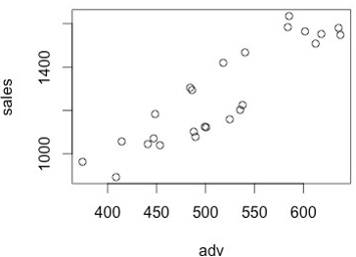
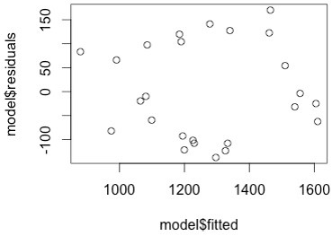
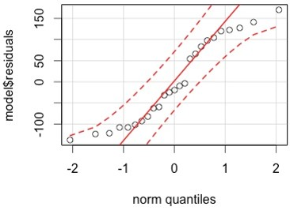
Example in R (cont’d)
The assumptions are:
Linearity, Constant Variance, Independence, and Normality.
Based on the above plots, the assumptions appear to hold.
plot(adv, sales)
plot(model$fitted, model$residuals)
library(car); qqPlot(model$residuals)

Slide 6
Example in R (cont’d)
Do you identify any outliers?
Based on the plots provided in part b, there do not appear to be outliers.
d. How much variability in sales is explained by the advertisement expenditure?
summary(model)$r.squared
[1] 0.8105919
Around 81% of the variability in sales is explained by the advertising expenditure.

Slide 7

Summary

